Slide 1


PROJECT REPORT
Predict Employment Termination
Instructor : Thanh Binh Nguyen
Duy Tri Nguyen Ho
1

Slide 2


MEMBERS
GROUP 18
TRONG KHANG HO
CAO KHOA NGUYEN
2

Slide 3

01. OVERVIEW
02. DATA PREPROCESSING
03. DATA VISUALIZATION
04. ALGORITHM & EXPERIMENT
05. CONCLUSION
OUTLINE
3

Slide 4
01
OVERVIEW
4

Slide 5
Rationale
In an organization, workers play an essential role and are the core of bringing
the innovation process into depth and promoting the industry
When someone terminates the contract at a specific position, it is necessary to
have another person replace that position
Create machines to make predictions about the employees who may terminate
the contract, helping the heads to have more insight into issues in the company such as working environment, the position of each employee, about the
departure of employees, thereby making decisions, future orientation
as well as having earlier preparation of their human resources
5

Slide 6
Aims of the study
It is possible to process and clean the collected data into a valuable data
source for the problem
Explore, analyze, and visualize data sets
Building a natural language data system, using machine learning to train machines
to make highly reliable information and predictions for humans
Compare efficiency and accuracy between models
Predict employee termination, help limit damages, and optimize work for
the organization
6

Slide 7
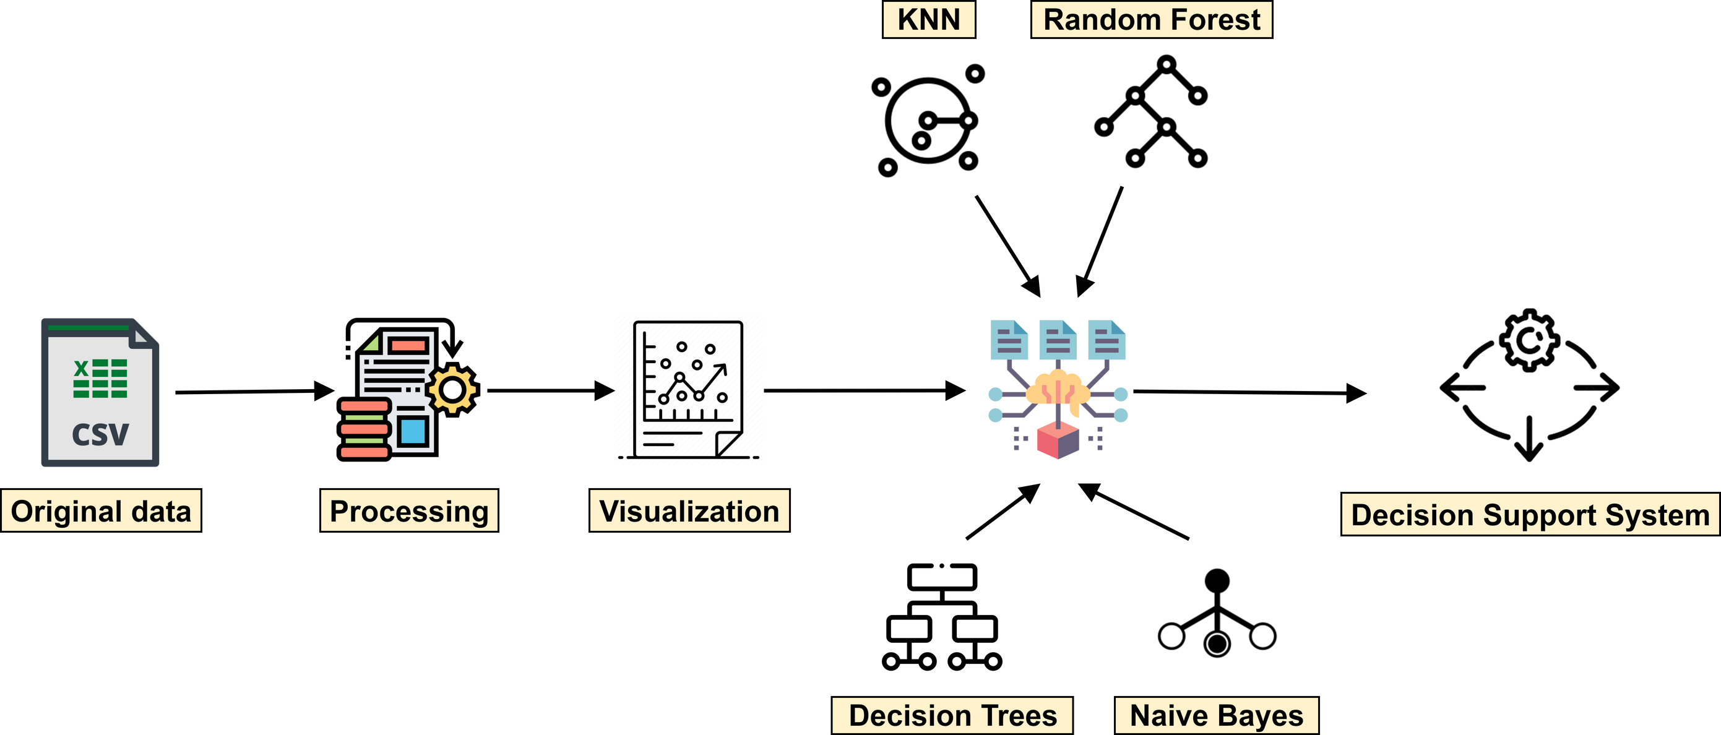
Process overview
7

Slide 8
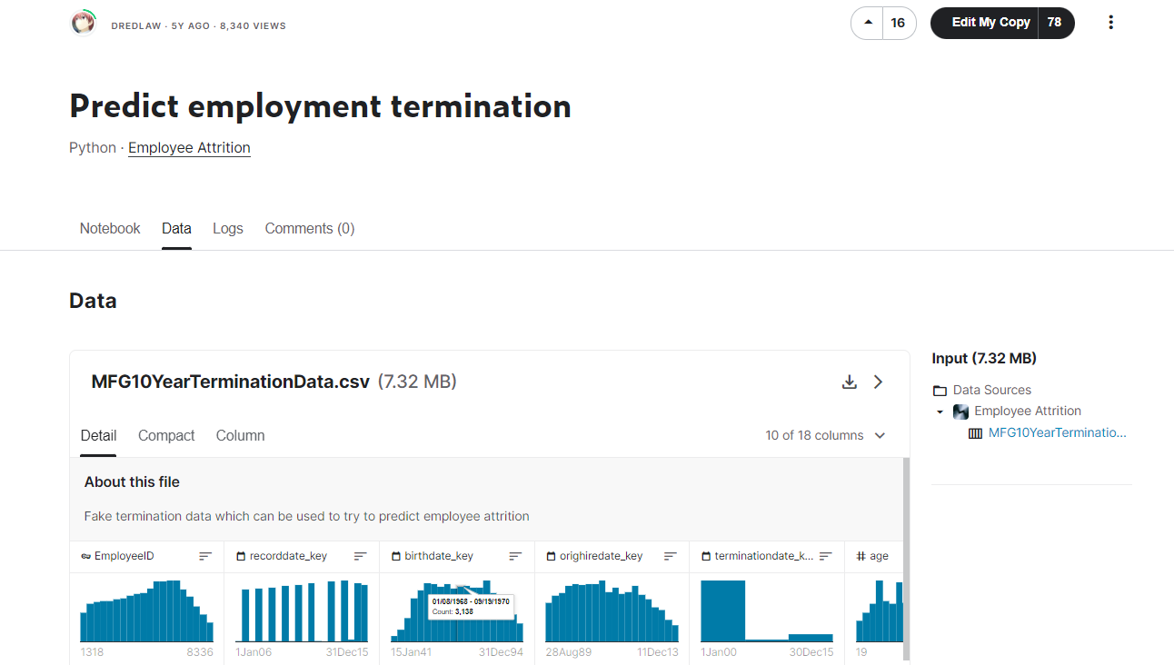
Dataset overview
Author : DREDLAW
The data warehouse collects information about employees (age, workplace, working time, location, ..) over the years 2006 to 2015
Through which users can know the following information:
Information of 6284 employees
The data store consists of 49653 rows and 18 attributes
8

Slide 9
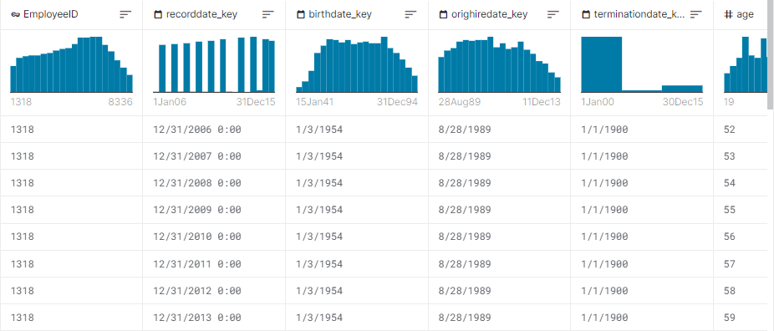
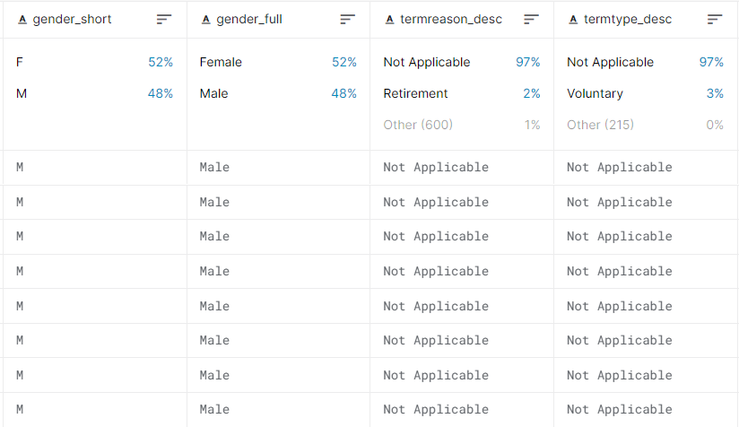
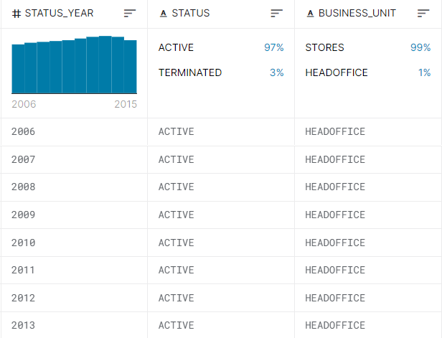
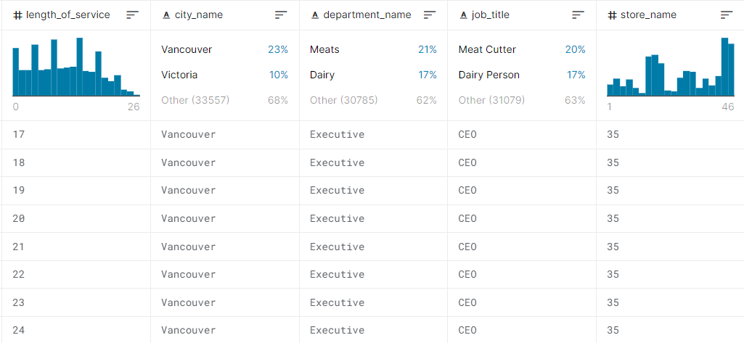
Data attributes
9

Slide 10
02
DATA PREPROCESSING
10

Slide 11
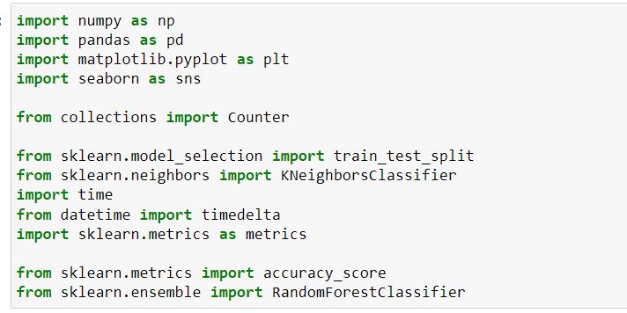
Import package & libraries
11

Slide 12
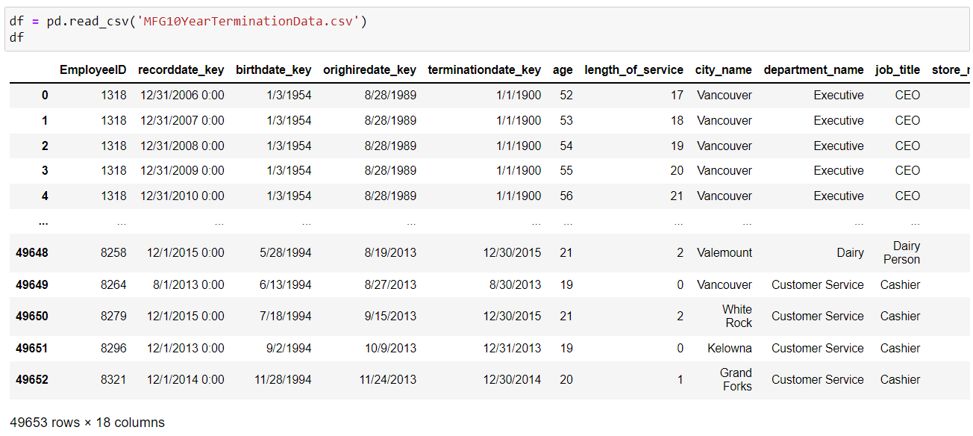
Import data file
12

Slide 13
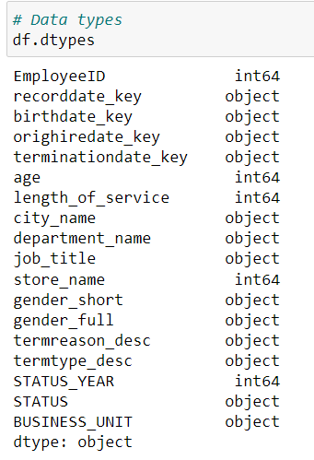
Check data type
13

Slide 14
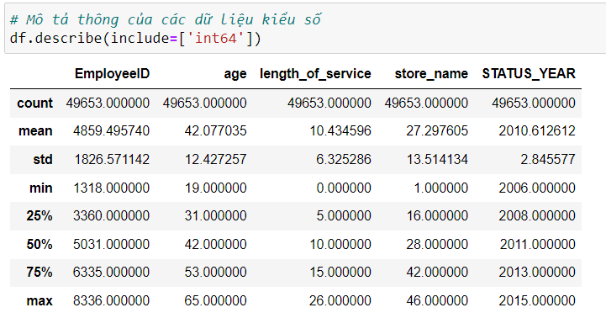
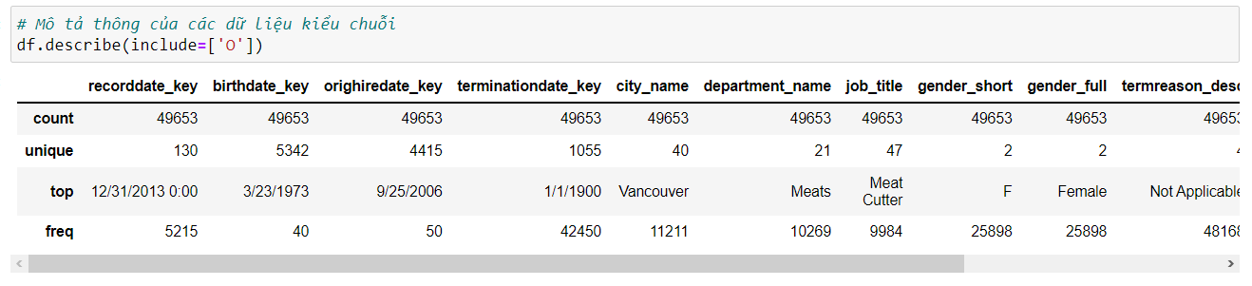
Description of information
non-numerical data
numerical data
14

Slide 15
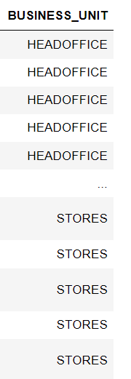
Change column BUSINESS_UNIT value
15

Slide 16
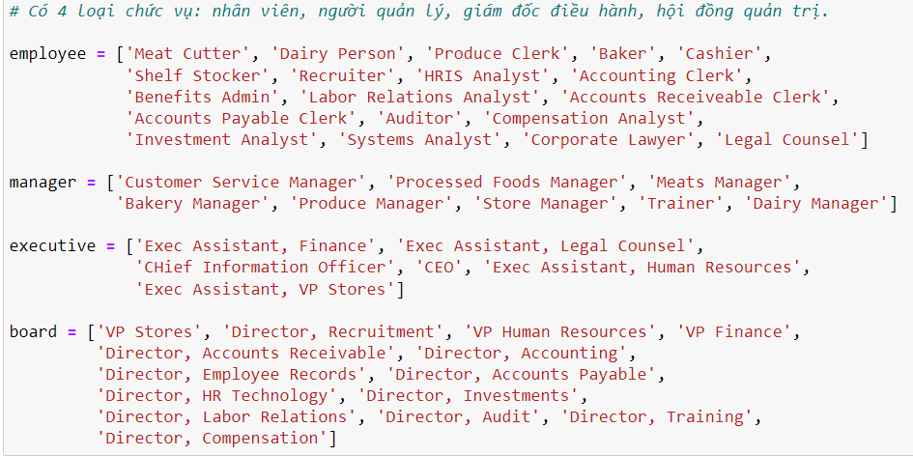
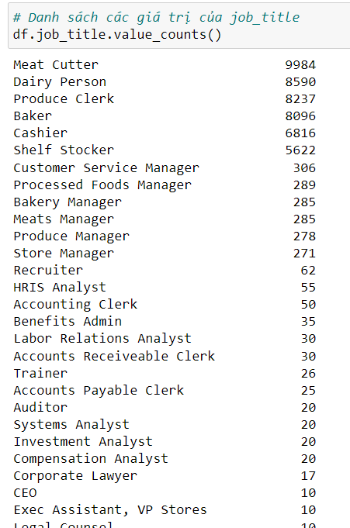
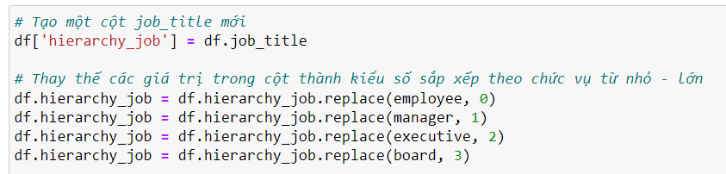
Create new categories for job_titles
47 jobs
Make a copy of job titles in a new column
Replace the job titles in Hierarchy by numeric
and order from small to large
Separated according to corporate hierarchy
16

Slide 17
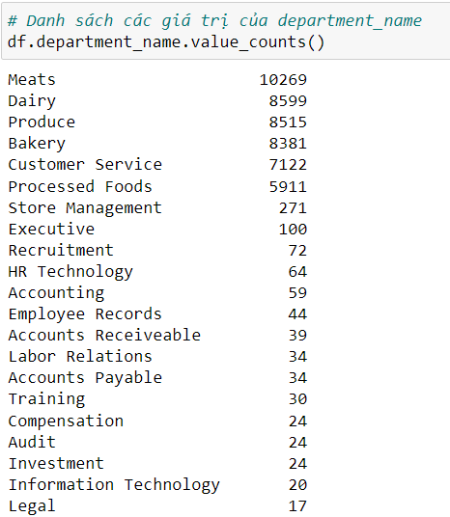
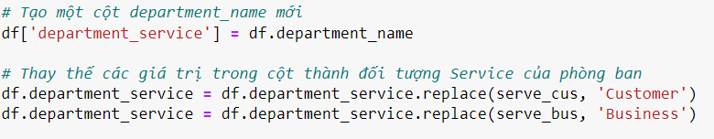
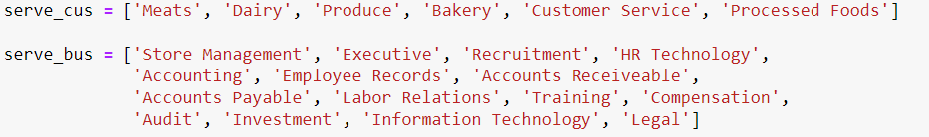
Create new categories for department_name
21 departments
Make a copy of job titles in a new column
Separated according to whether they serve the customer
Replace the department name with a service object
17

Slide 18
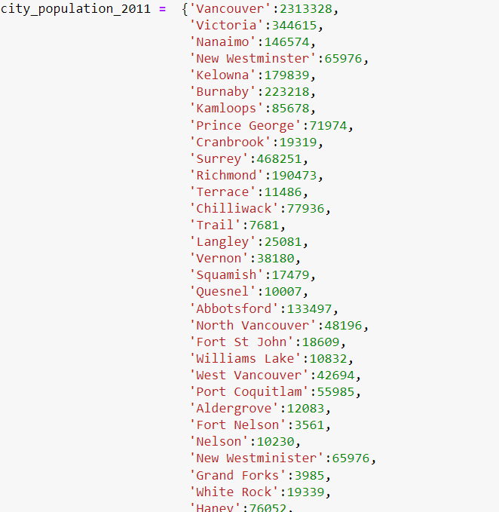
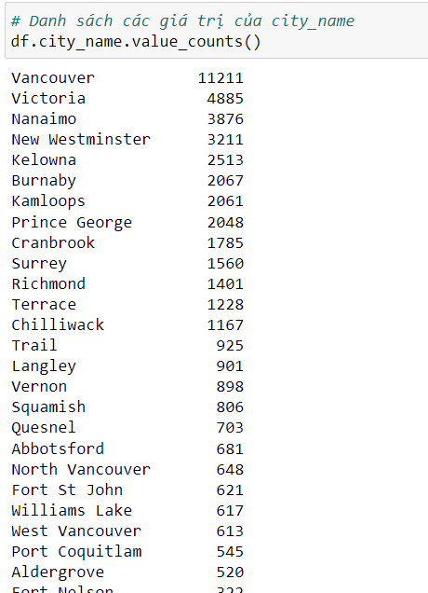
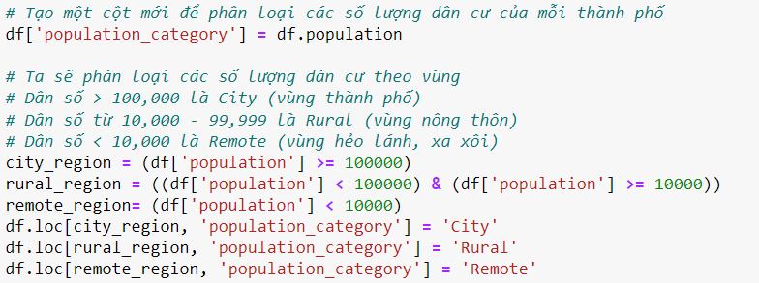
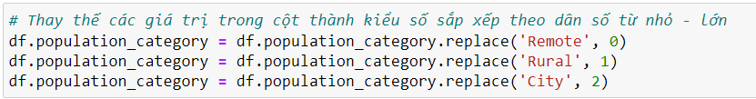
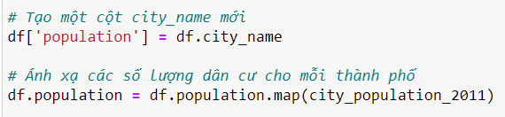
Create new categories for city_name
Separated according to population size
40 cities
Replace the population category by numeric
and order from small to large
Make a copy of city name in a new column
Map from city name to population
Make a new column for population category
Categorise according to population size
18

Slide 19
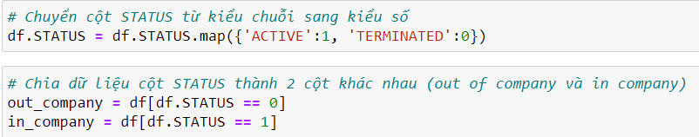
Data processing for column STATUS
19

Slide 20
03
DATA VISUALIZATION
20

Slide 21
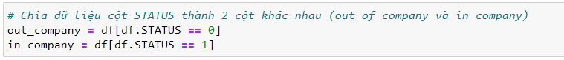
Separate the data of column STATUS
Separate data to avoid one excessively overlapping
the other in plots
One set for the
terminated (out of company) and working (in company)
21

Slide 22
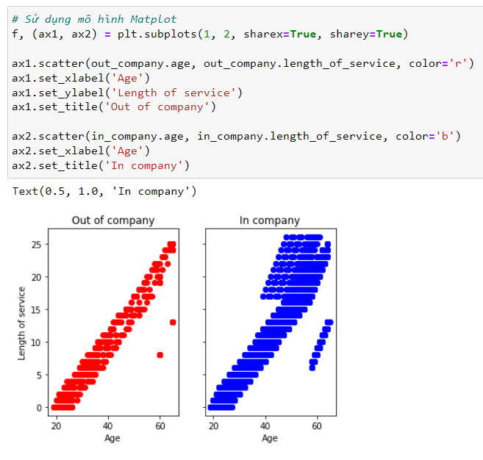
Look at each group in terms
of age and length of service
People may leave the company
after working for any length of time
from 0 to 25 years and any age
from 20 to 60
22

Slide 23
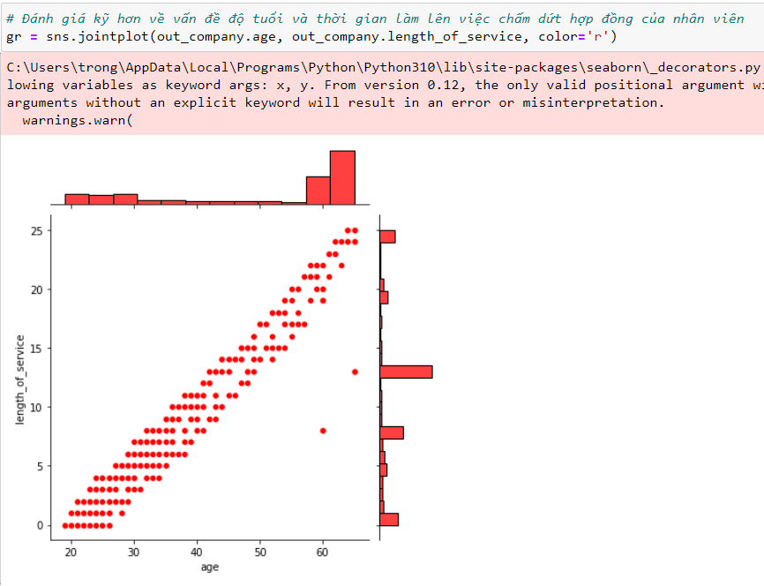
Take a closer look at
the distribution of ages
and service times
for terminations
About 25-27 years old overlaps the service peak of 1-3 years. This is likely people who feel unfit for the job or work environment.
About 19-24 years old overlaps the service peak of 0 years. This is likely people who are trying jobs to find something they would like.
58-61 years old overlaps the service peak of 19-21 years. This is also would be people who are retiring from the work force.
Above 61 years old overlaps the service peak of 25 years. This would be people who are retiring from the work force.
About 28-31 years old overlaps the service peak of 8 years. This is likely people who have become tired of their work and want a career change. It may also be people who have family commitments that force them to change.
23

Slide 24
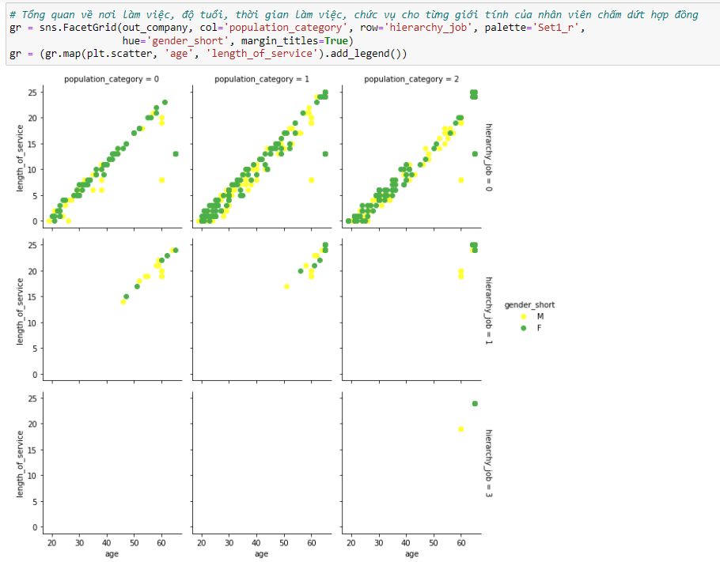
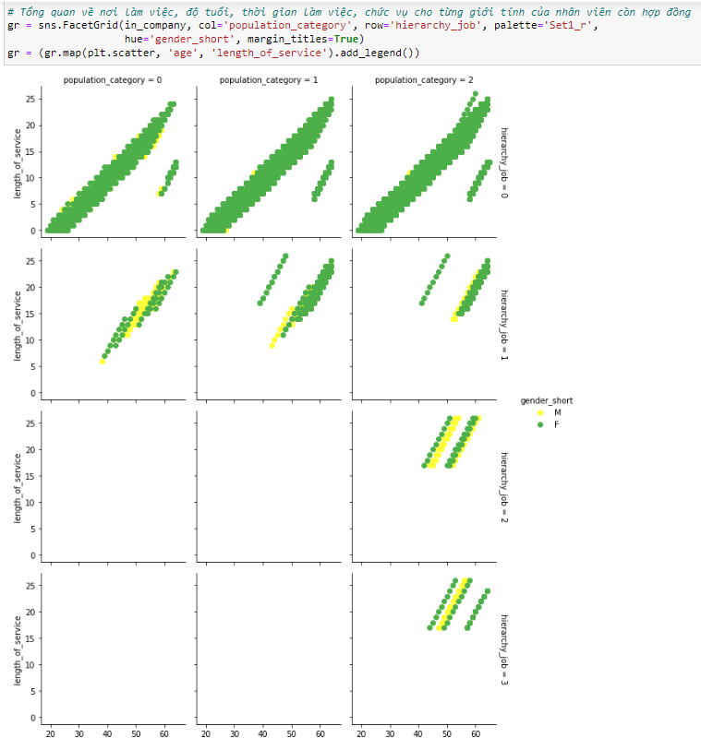
Nobody has stopped employment when they were at executive level
There does not appear to be a major difference in employment termination between males and females
Managers and board members stop employment after at least 14 years of service. This means that they were likely internally promoted to those positions
When someone leaves the company, look at their age, length of service, city size and position in hierarchy. Separated by gender
Do the same for people who are working
in the company
Executives and board members only work in cities
24

Slide 25
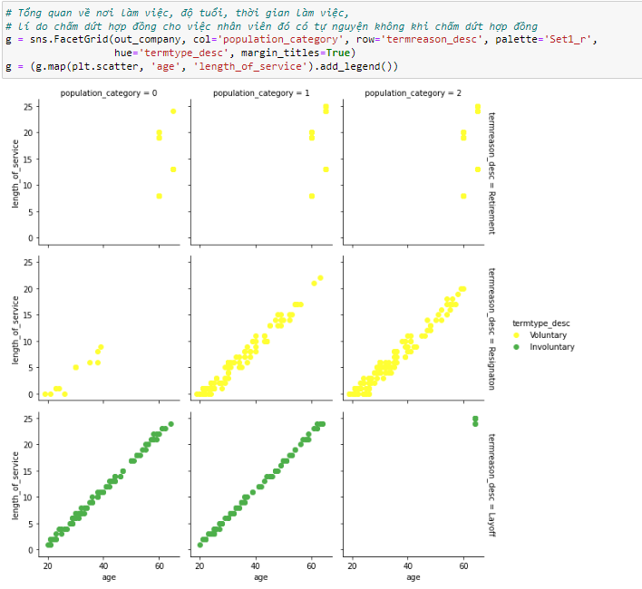
Look at when termination is voluntary or involuntary
Layoffs occur for all ages and all service lengths in remote and rural areas
Resignations are uncommon in remote areas
As expected, layoffs are involuntary, whereas resignations and retirements are voluntary
25

Slide 26
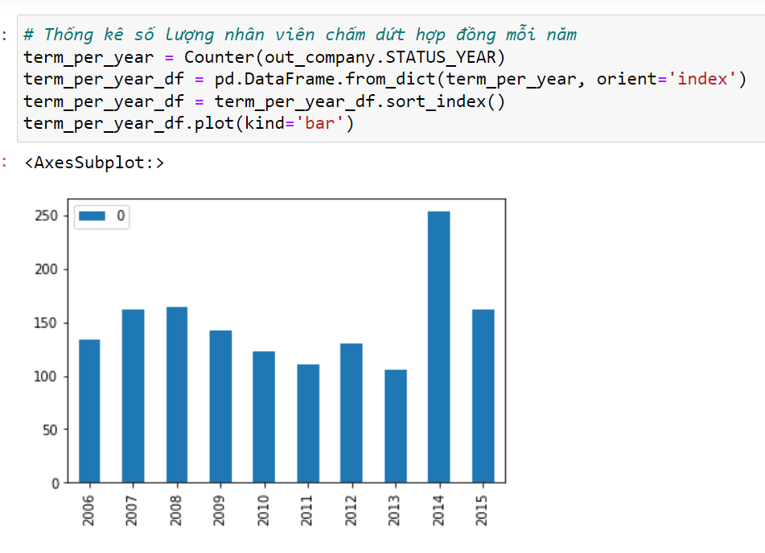
Look at number of terminations per year
2014 had an unusually high number of employment terminations
There was a peak in employment terminations in 2007-2008, when the GFC occurred
Employment terminations in 2015 is similar to the GFC peak, but much lower than the 2014 peak
26

Slide 27
04
ALGORITHM & EXPERIMENT
27

Slide 28
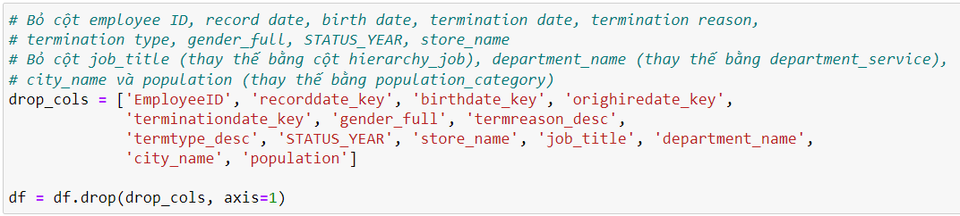
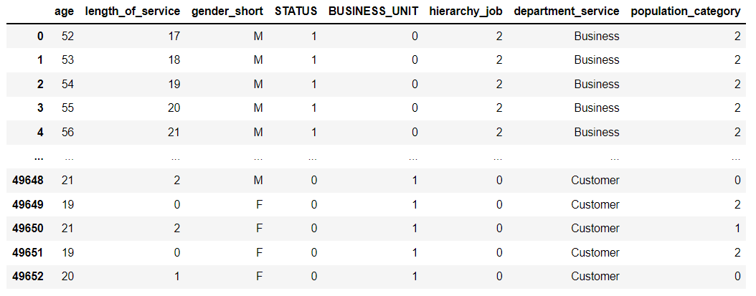
Delete processed columns
28

Slide 29
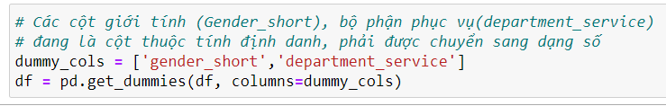
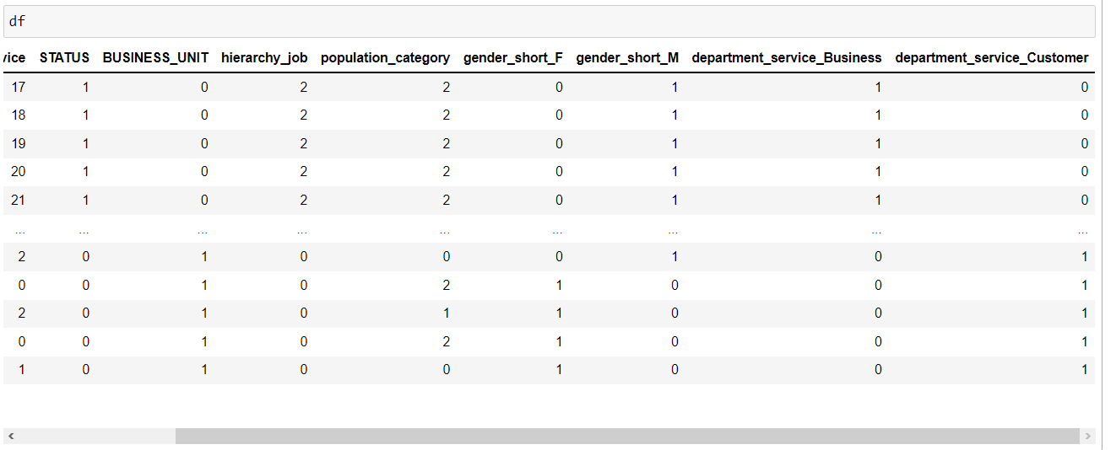
Dummy columns
29

Slide 30
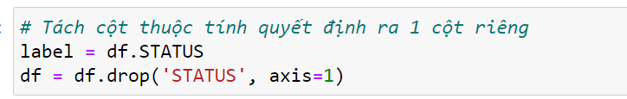
Split the decision attribute column into a separate column
30

Slide 31
Separate train and test data (train=70%, test=30%)
31

Slide 32

K-nearest neighbor
32

Slide 33
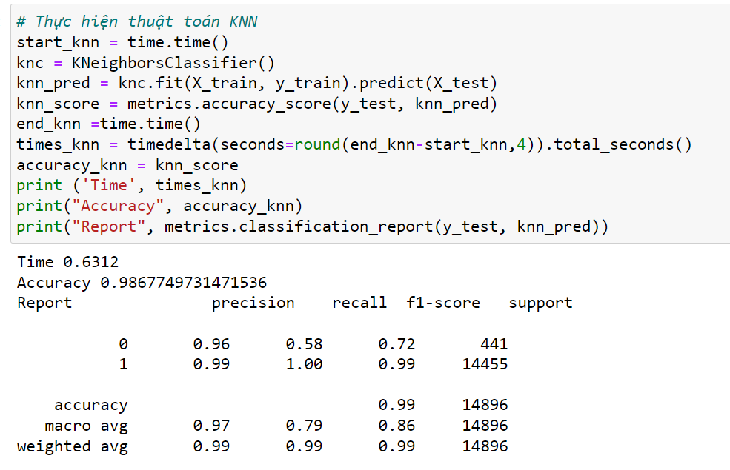
33

Slide 34
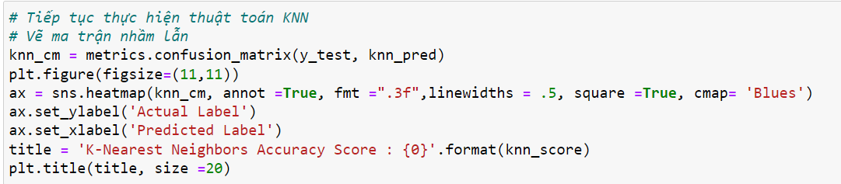
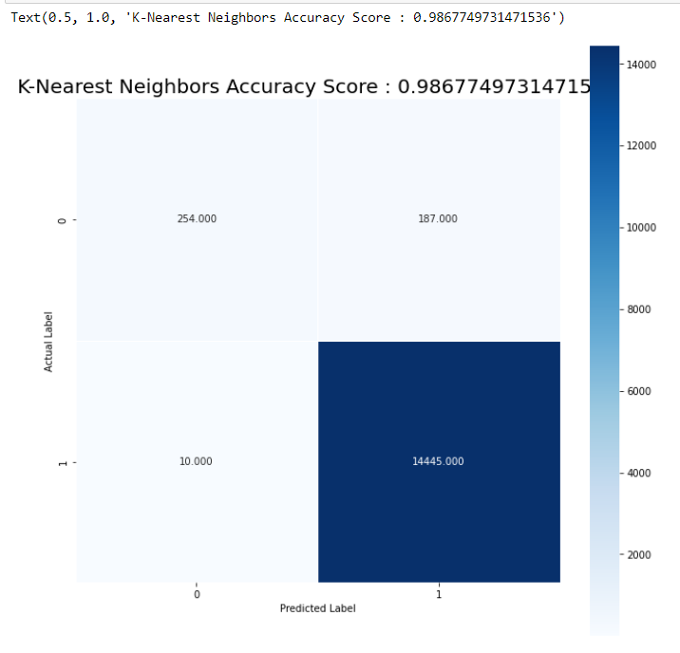
Confusion Matrix
34

Slide 35

Random Forest
35

Slide 36
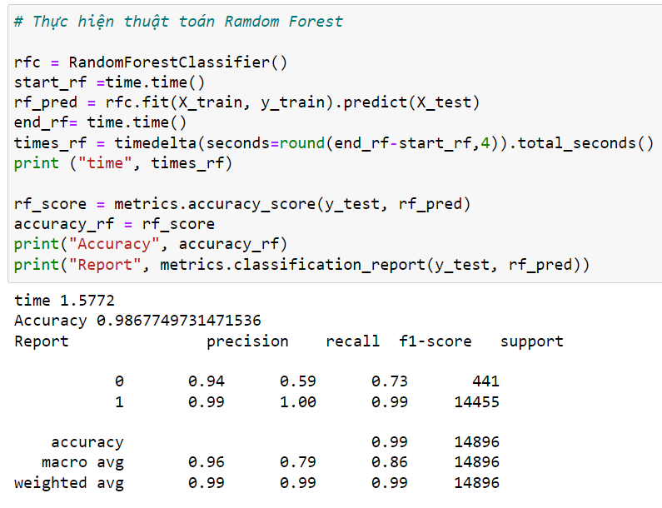
35

Slide 37
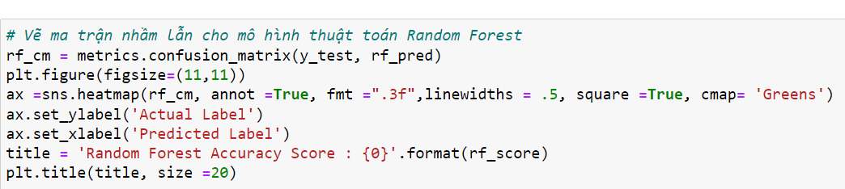
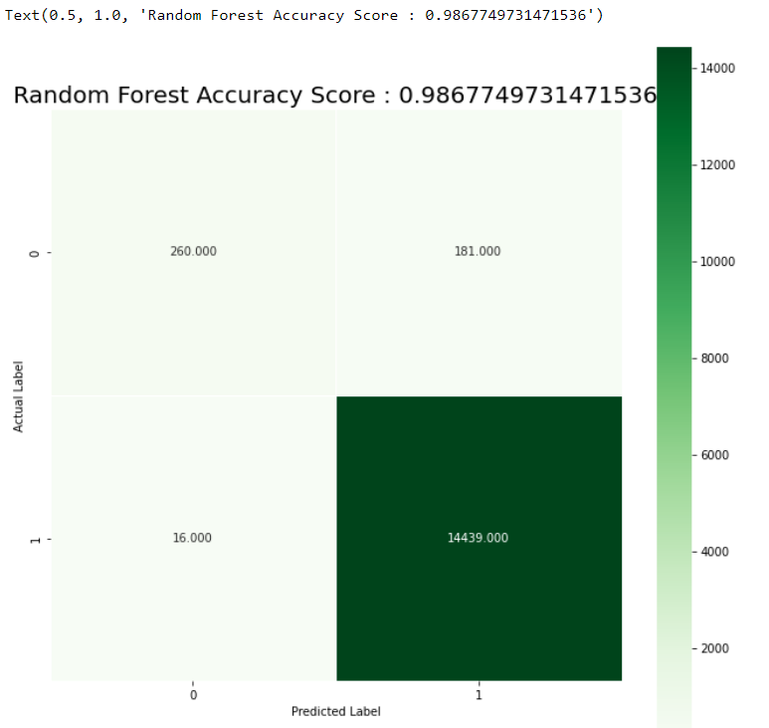
Confusion Matrix
37

Slide 38
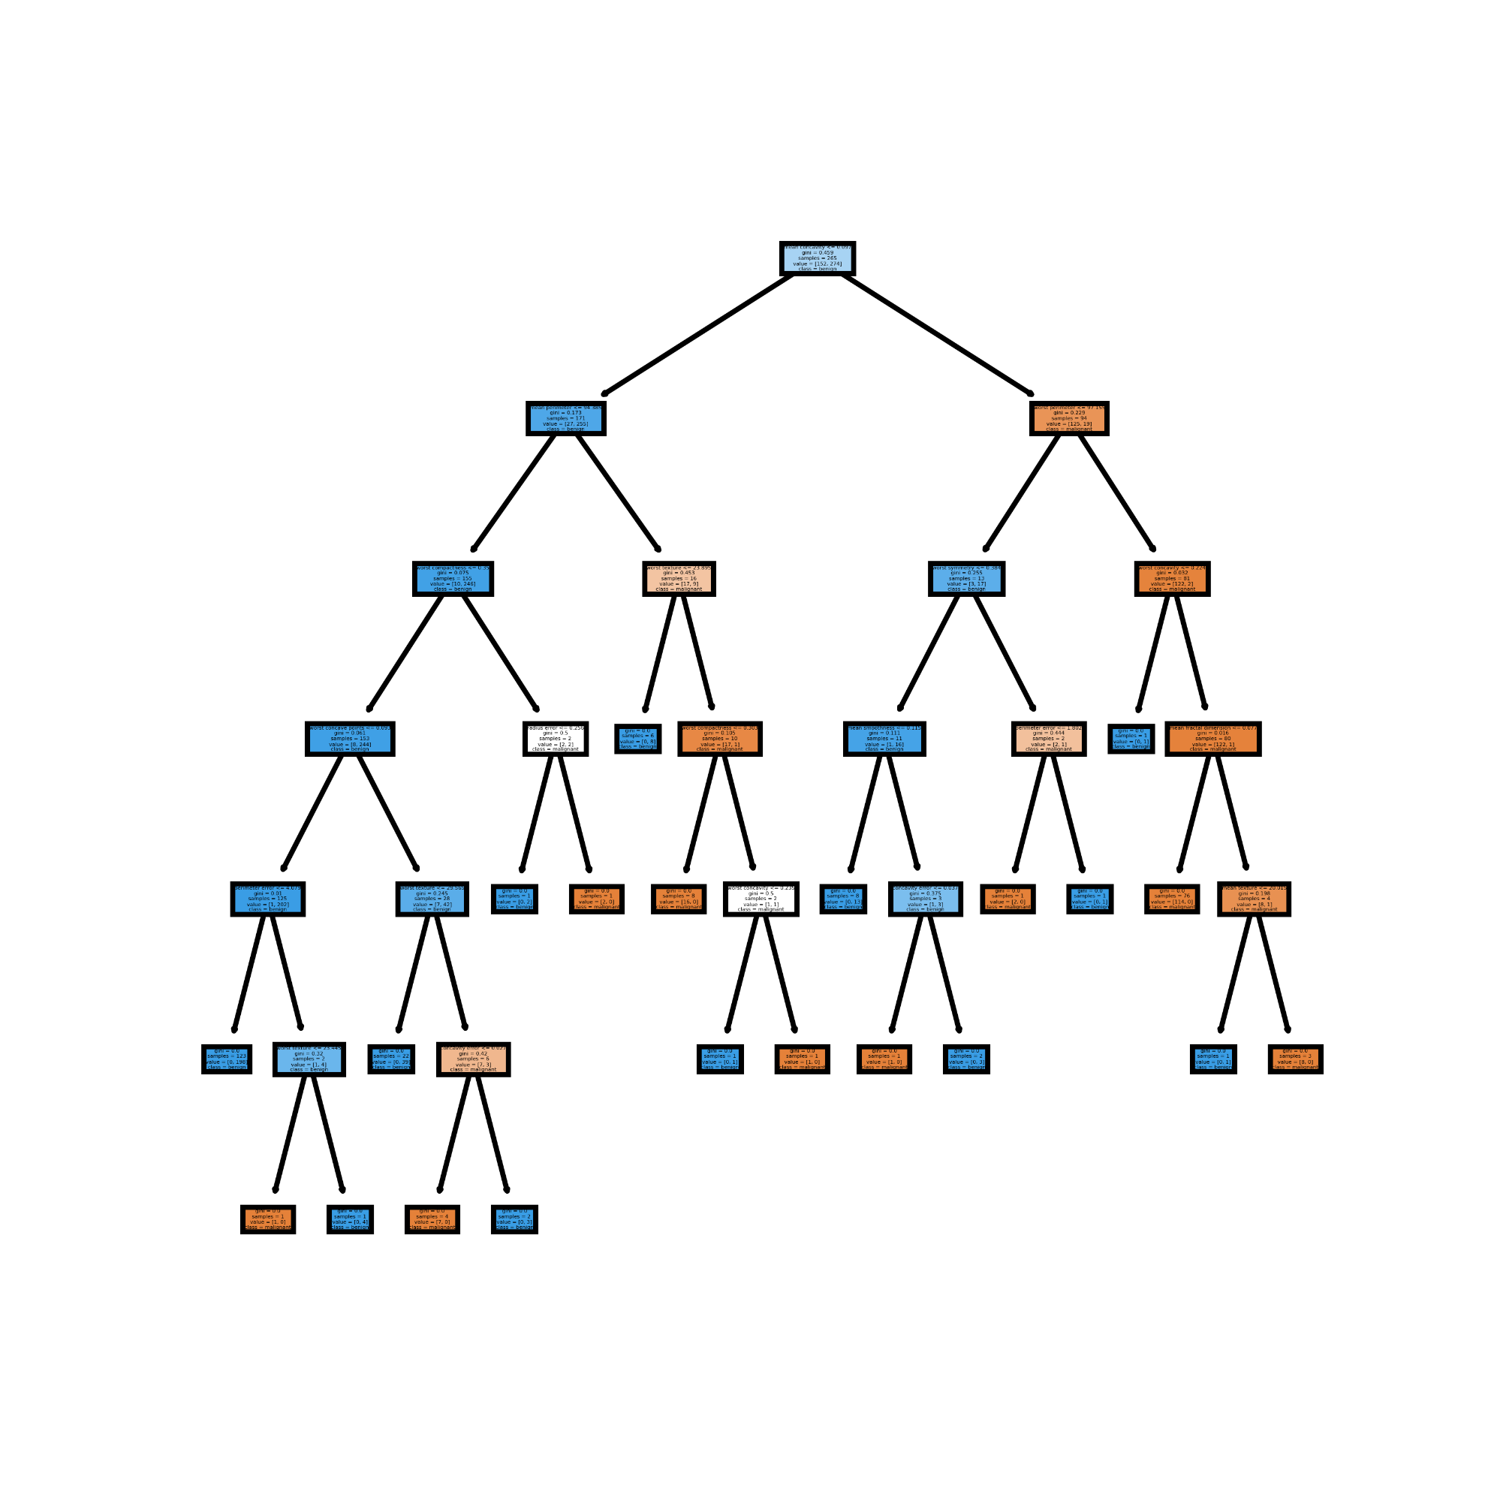
Decision Trees
38

Slide 39
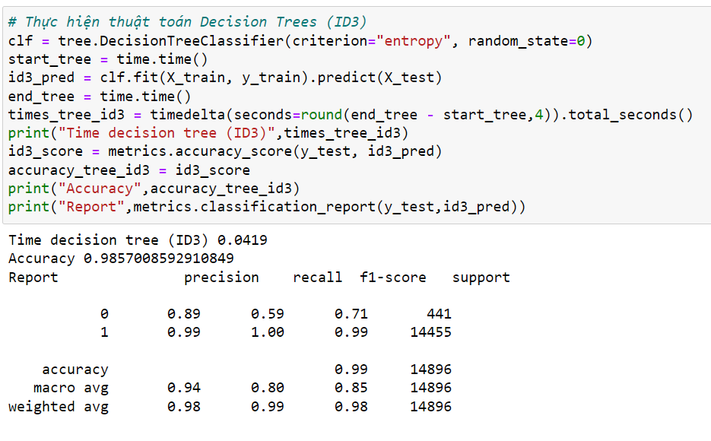
ID3
39

Slide 40
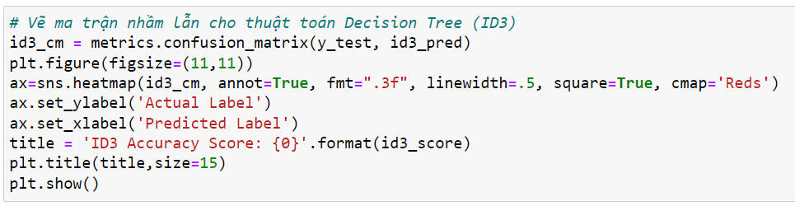
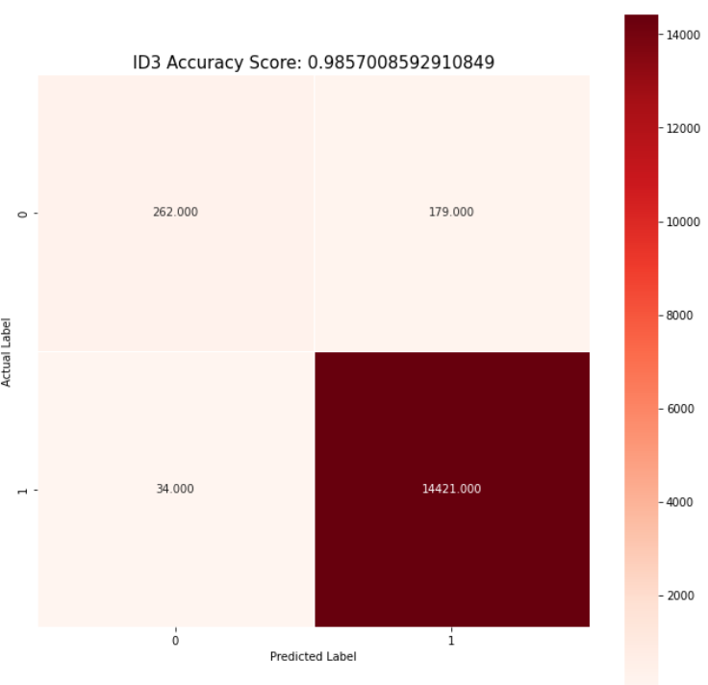
Confusion Matrix
40

Slide 41
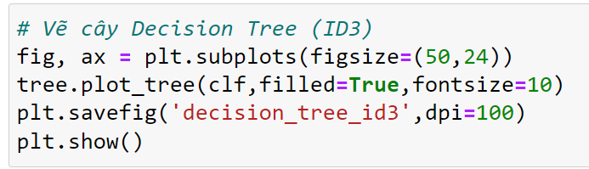
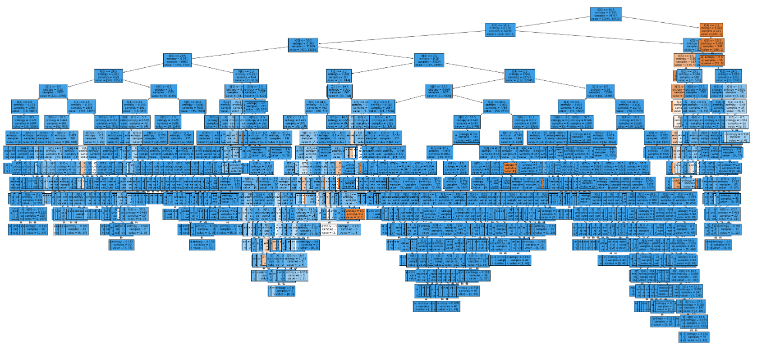
Decision Trees
41

Slide 42
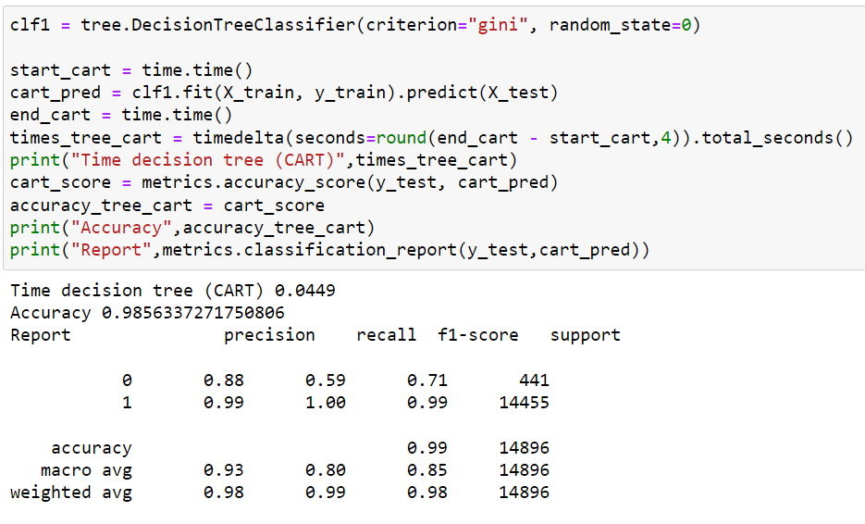
CART
42

Slide 43
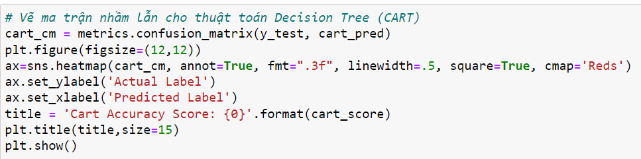

Confusion Matrix
43

Slide 44

Decision Trees
44

Slide 45

Naive Bayes
45

Slide 46

46

Slide 47


Confusion Matrix
47

Slide 48
05
CONCLUSION
48

Slide 49


Run time comparison
49

Slide 50


Accuracies comparison
50

Slide 51

Run App
51

Slide 52

Thanks For Listening
#Group 18
52

